Slide 1
Greedy method

Slide 2
A greedy algorithm is an approach for solving a problem by selecting the best option available at the moment, without worrying about the future result it would bring.
In other words, the locally best choices aim at producing globally best results.

Slide 3
Advantages
The algorithm is easier to describe.
This algorithm can perform better than other algorithms (but, not in all cases).

Slide 4
Greedy Algorithm
To begin with, the solution set (containing answers) is empty.
At each step, an item is added into the solution set.
If the solution set is feasible, the current item is kept.
Else, the item is rejected and never considered again.

Slide 5
Basic Concepts
Spanning Trees: A subgraph T of a undirected graph G = ( V, E ) is a spanning tree of G if it is a tree and contains every vertex of G.
b
a
Every connected graph has a spanning tree.
May have multiple spanning tree.
For example see this graph.
c
e
d
Graph
b
b
b
a
a
a
c
c
c
e
e
e
d
d
d
Spanning Tree 1
Spanning Tree 2
Spanning Tree 3

Slide 6


Spanning Tree Cont…

Slide 7
Basic Concepts Cont…..
Weighted Graph: A weighted graph is a graph, in which each edge has a weight (some real number ) Example:
b
a
7
32
c
10
23
9 e
d
Weighted Graph

Slide 8
Basic Concepts Cont….
Minimum Spanning Tree in an undirected connected weighted graph is a spanning tree of minimum weight. Example:
b
a 7 32
c
10
23
9 e
d
Weighted Graph
a
32
b
a
7
32
b
a
7
32
b
c
c
c
10
23
23
10 23
9 e
9 e
e
d
d
d
Spanning Tree 3, w=72
Spanning Tree 1,
w=74
Spanning Tree 2,
(Minimum Spanning Tree)
w=71

Slide 9
Minimum Spanning Tree Problem
MST Problem : Given a connected weighted undirected graph G, design an algorithm that outputs a minimum spanning tree (MST) of graph G.
How to find Minimum Spanning Tree ?
Generic solution to MST
Two Algorithms
Kruskal’s algorithm
Prim’s algorithm

Slide 10
Applications of Minimum Spanning Tree
Consider n stations are to be linked using a communication network & laying of communication links between any two stations involves a cost. The ideal solution would be to extract a subgraph termed as minimum cost spanning tree.
Suppose you want to construct highways or railroads spanning several cities then we can use the concept of minimum spanning trees.
Designing Local Area Networks.
Laying pipelines connecting offshore drilling sites, refineries and consumer markets.
Suppose you want to apply a set of houses with
Electric Power
Water
Telephone lines
Sewage lines
To reduce cost, you can connect houses with minimum cost spanning trees.

Slide 11
Kruskal’s Algorithm
The set of edges (T) is initially empty.
As the algorithm progresses, edges are added to T at every instance.
The partial graph formed by the nodes of G, and the edges in T consists of several connected components.
At the end of the algorithm, only the connected component remains, so that T is then a minimum spanning tree of all nodes of G.

Slide 12
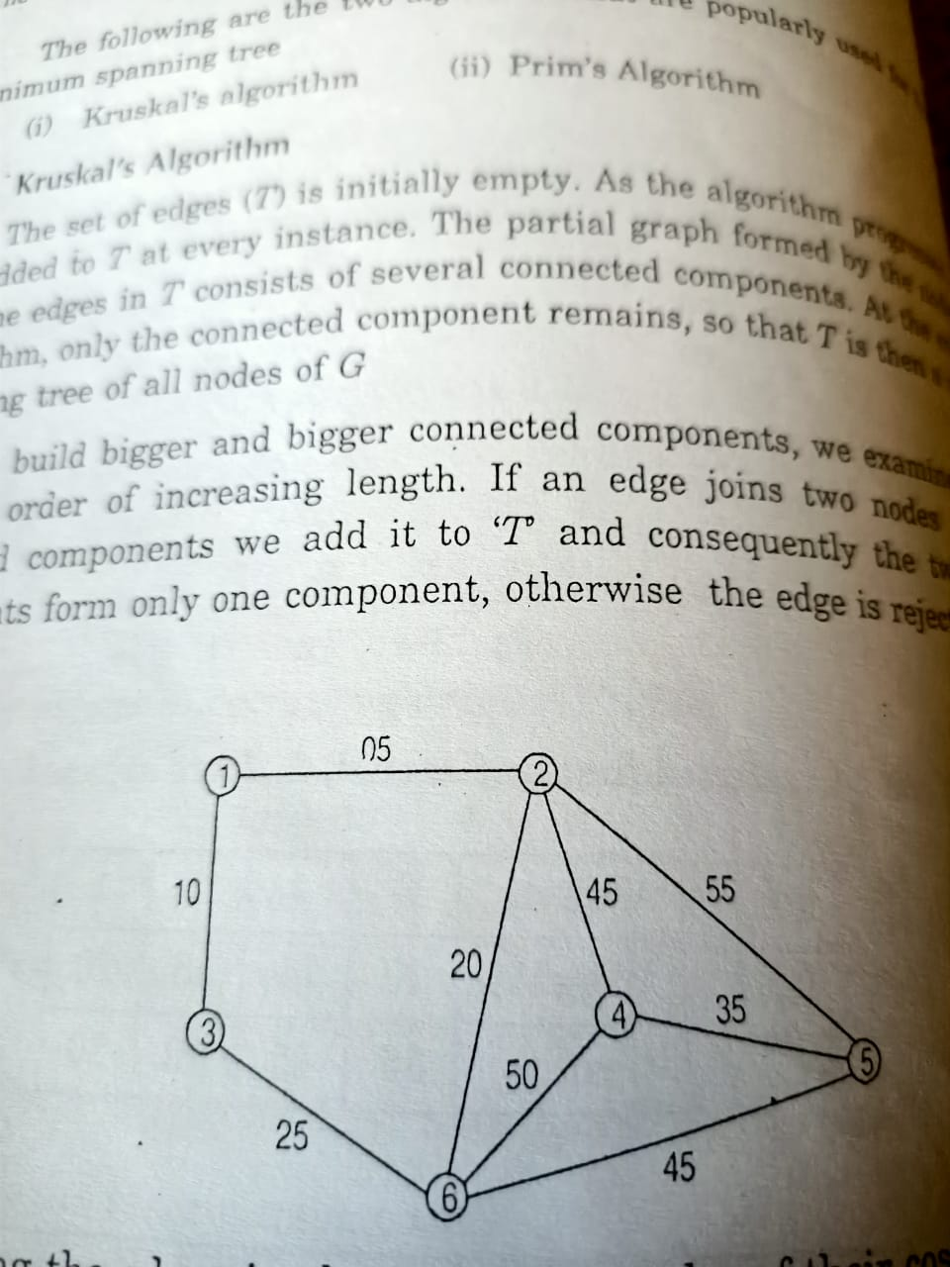
Example Graph

Slide 13
The steps for implementing Kruskal's algorithm are as follows:
Sort all the edges from low weight to high
Take the edge with the lowest weight and add it to the spanning tree. If adding the edge created a cycle, then reject this edge.
Keep adding edges until we reach all vertices.

Slide 14
First step to solve is to arrange the edges in the increasing order of their costs.

Slide 15
Edge | Cost
1 - 2 | 5
1 - 3 | 10
2 – 6 | 20
3 - 6 | 25
4 - 5 | 35
2 - 4 | 45
5 - 6 | 45
4 - 6 | 50
2 - 5 | 55

Slide 16
Next step is to create the following table

Slide 17
Step | Edge Considered | Connected component | Graph
Initial | - | [1] [2] [3] [4] [5] [6] | -
1. | [1 – 2] | [12] [3] [4] [5] [6] Accepted because no cycle
2. | [1 – 3] | [1 2 3] [4] [5] [6] Accepted because no cycle
5
1
2
5
1
2
10
3

Slide 18
Step | Edge Considered | Connected Component | Graph
3. | [2 – 6] | [1 2 3 6] [4] [5] Accepted because no cycle
4. | [3 – 6] | Rejected because it forms a cycle | -
5. | [4 – 5] | [1 2 3 6] [4 5] Accepted because no cycle
5
1
2
10
20
3
6
1
5
2
10
20
35
4
5
3
6

Slide 19
Step | Edge Considered | Connected Component | Graph
6. | [2 – 4] | [1 2 3 4 5 6] Accepted because no cycle
7. | [5 – 6] | rejected | -
8. | [4 – 6] | rejected
5
45
10
20
35

Slide 20
Step | Edge Considered | Connected Component | Graph
8. | [4 - 6] | Rejected | -
9. | [2 – 5] | Rejected | -

Slide 21
Algorithm Kruskal(T,E,n)
T is the spanning tree, E is the list of edges, n is the number of nodes in given graph G
{
initially T=0;
while ( T <> n-1 and E <> 0 )
{
find the min-cost edge in E and call it as (U,V)
if (U,V) does not form a cycle
T = T + (U,V)
else
delete(U,V);
}
if ( |T| = n-1 )
display “Spanning Tree,T”
else
display “No Spanning Tree”
}

